Slide 1


HBase on Hadoop: a distributed column based solution
Gabriele Matini 1934803,
Alessio Maiola 1937744
Tutti i diritti relativi al presente materiale didattico ed al suo contenuto sono riservati a Sapienza e ai suoi autori (o docenti che lo hanno prodotto). È consentito l'uso personale dello stesso da parte dello studente a fini di studio. Ne è vietata nel modo più assoluto la diffusione, duplicazione, cessione, trasmissione, distribuzione a terzi o al pubblico pena le sanzioni applicabili per legge
Notes:
‹#›

Slide 2
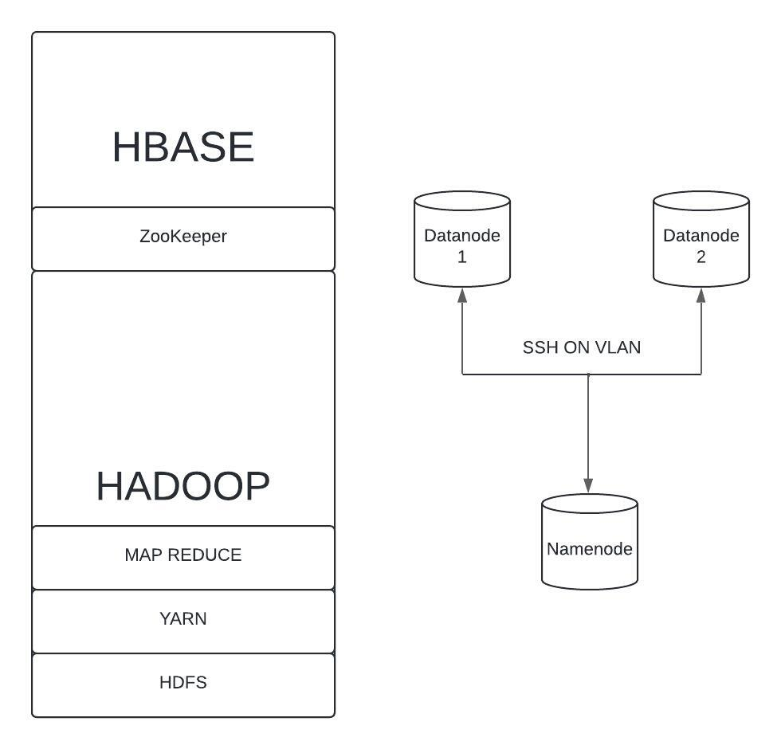
The overall architecture
The main components
Two “main” layers: Hadoop
and HBase.
Communication handled
through SSH and a VLAN
HBase on Hadoop
*
Pagina ‹#›
Notes:
‹#›

Slide 3
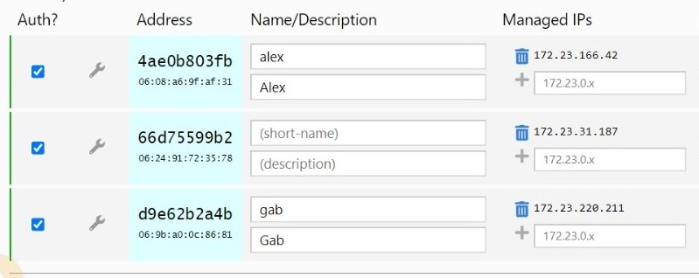
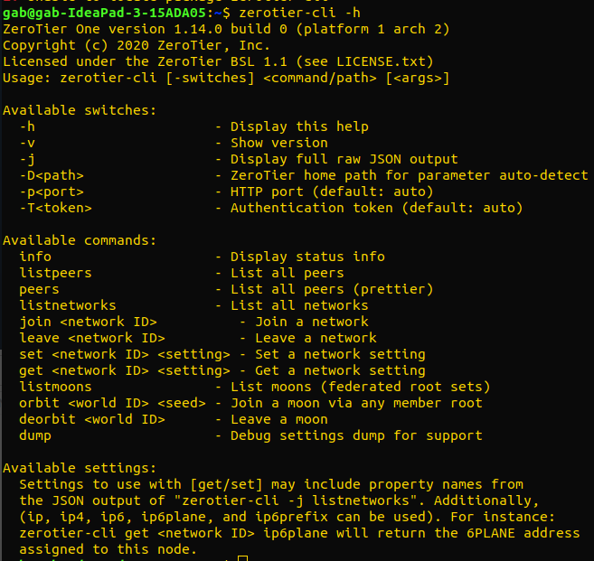

The Setup: ZeroTier
A useful VLAN service
go on the zerotier site and subscribe to create a free VLAN network
install zerotier-cli on every node and use the commands to have the nodes join the VLAN
HBase on Hadoop
Pagina ‹#›
Notes:
‹#›

Slide 4

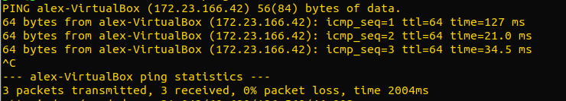
The Setup: exchange hostnames
go to each node machine and on register the virtual IPs of the other nodes. Hostnames can be chosen at will.
in Linux we can do this by editing the etc/hosts file:
finally, test your VLAN with a ping command:
HBase on Hadoop
Pagina ‹#›
Notes:
‹#›

Slide 5
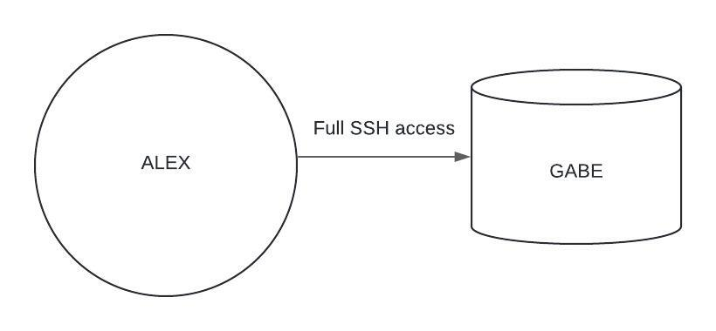
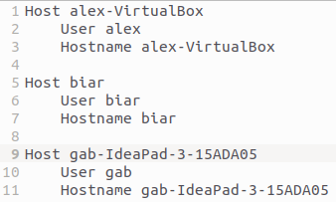

The Setup: SSH communication
generate a private-public key pair on the namenode
put the public key into the “authorized_keys” file in ~/.ssh on each datanode and enable PubKey authentication on each datanode
to enable pubkey auth. go to etc/ssh/sshd_config and edit it as follows:
HBase on Hadoop
Pagina ‹#›
Notes:
‹#›

Slide 6

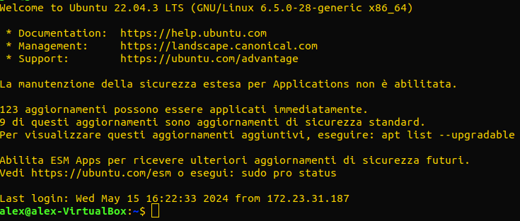
The Setup: SSH communication
to test your ssh connection, just log into a remote datanode:
Pagina ‹#›
Notes:
‹#›

Slide 7
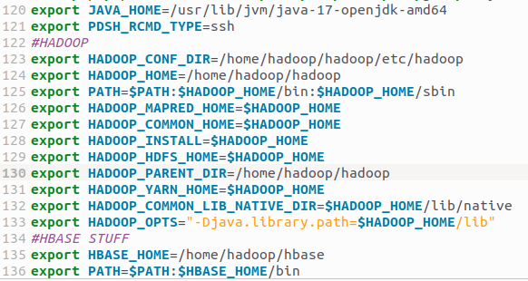
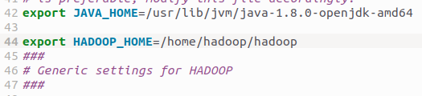
The Setup: Hadoop
Install Java 8 on your machine and put your hadoop install in home/hadoop
Set the paths in bashrc as we as in $HADOOP_HOME/etc/hadoop/hadoop-env.sh
HBase on Hadoop
Pagina ‹#›
Notes:
‹#›

Slide 8
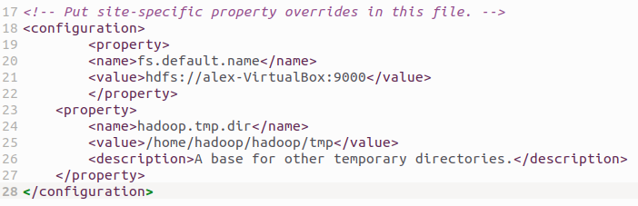
The Setup: Hadoop
Edit the file core-site.xml in $HADOOP_HOME/etc/hadoop/ as follows:
HBase on Hadoop
Pagina ‹#›
Notes:
‹#›

Slide 9
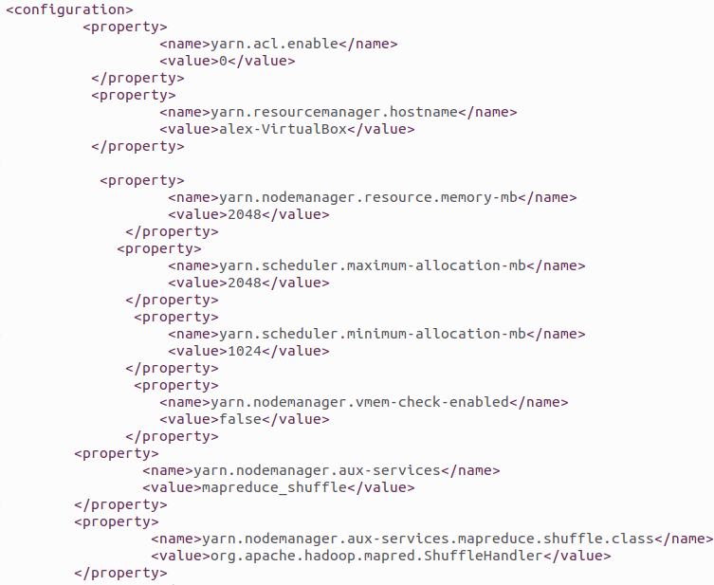
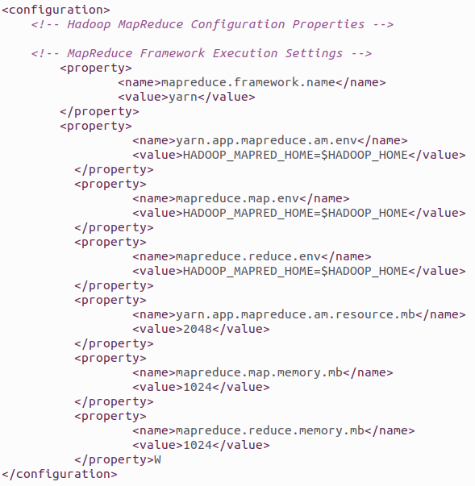
The Setup: YARN and MapReduce on Hadoop
Edit the file yarn-site.xml and mapred-site.xml in $HADOOP_HOME/etc/hadoop/ as follows:
HBase on Hadoop
Pagina ‹#›
Notes:
‹#›

Slide 10
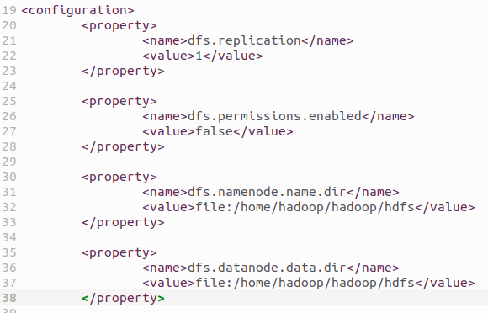
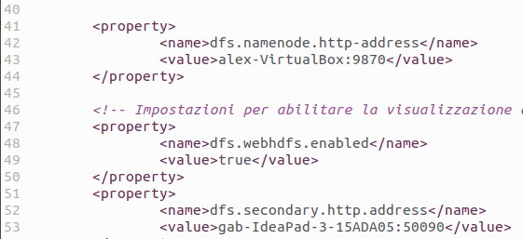
The Setup: HDFS
Edit the file hdfs-site.xml in $HADOOP_HOME/etc/hadoop/ as follows:
Note: to test now your configuration run “start-dfs.sh” and “start-yarn.sh” inside $HADOOP_HOME. Run “jps” to monitor the nodes, the resource manager and the node manager of YARN.
HBase on Hadoop
Pagina ‹#›
Notes:
‹#›

Slide 11

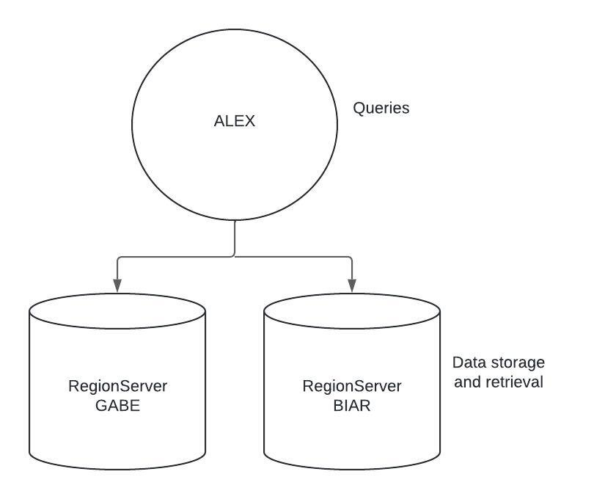

The Setup: HBase
Download HBase separately and edit conf/hbase-env.sh:
Then edit the regionservers file in the same folder to contain the datanode hostnames:
Note: pay attention to the Hadoop and HBase versions!
HBase on Hadoop
Pagina ‹#›
Notes:
‹#›

Slide 12
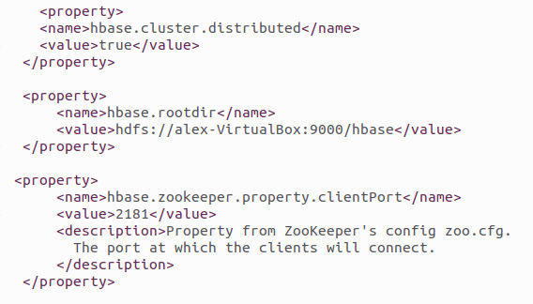
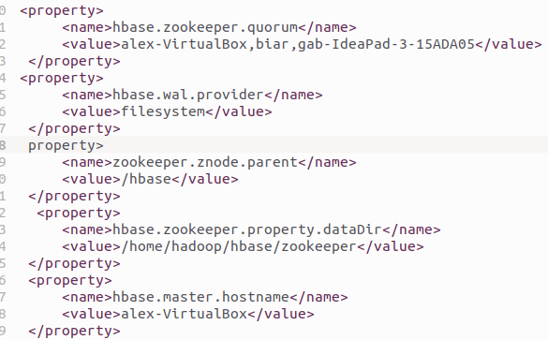
The Setup: HBase
Configure now HBase and ZooKeeper, editing hbase-site.xml:
Run start-hbase.sh in $HBASE_HOME to test hbase on top of an already functioning hadoop cluster.
Note: all nodes must have the same Hadoop and HBase configurations!
HBase on Hadoop
Pagina ‹#›
Notes:
‹#›

Slide 13
The Setup: Final configuration
Hadoop:
Namenode
ResourceManager
HBase:
HMaster
HQuorumPeer
alex
gab
biar
Hadoop:
Datanode
NodeManager
HBase:
HRegionServer
HQuorumPeer
Hadoop:
Datanode
NodeManager
SecondaryNamenode
HBase:
HRegionServer
HQuorumPeer
Notice: each component could run on a separate node!
HBase on Hadoop
Pagina ‹#›

Slide 14
Data representation
HBase creates the following structure in HDFS
/namespace/tablename
/region1
/cf1
<HFiles for cf1>
/cf2
<HFiles for cf2>
/region2
/cf1
<HFiles for cf1>
/cf2
<HFiles for cf2>
Tables are divided into regions by rows.
HFiles corresponding to different column families are stored in separate folders.
Efficient retrieval of values from the same column family in a range of rows.
Replication of HFiles dealt by HDFS.
HBase on Hadoop
Pagina ‹#›

Slide 15
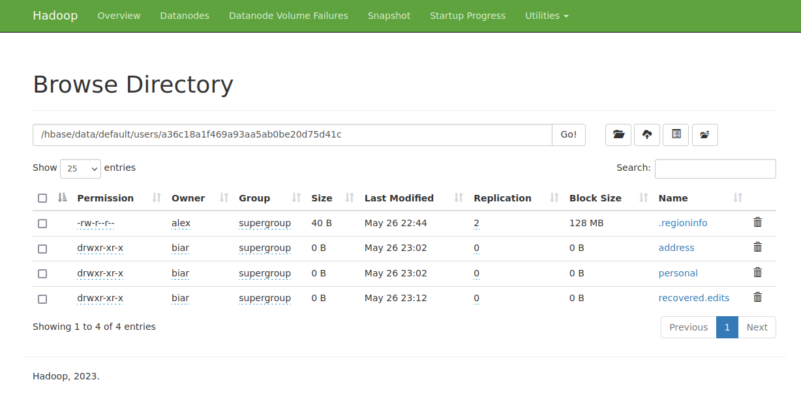
tablename
region
namespace
column families
HBase on Hadoop
Pagina ‹#›

Slide 16
HBase structure: region servers
Responsible for managing read/write operations.
Accounts all the writes in Write-Ahead Logs to guarantee durability.
Stores recently added data in the MemStore.
Automatically flushes MemStore into HDFS.
Automatically compacts data to ease retrieval.
Caches frequently accessed data into the BlockCache.
During read, checks whether data is in MemStore or BlockCache before accessing HDFS.
WALs (stored and replicated in hdfs) are used to reconstruct operations on the data in case of region server failure.
HBase on Hadoop
Pagina ‹#›

Slide 17
HBase structure: HMaster
Manages tables, including their schema, column families and versions of the data.
Assigns the regions to Region Servers, dynamically balancing the load.
Manages recovery of regions from faulty region servers, assigning them to the available ones.
Monitors the state of the cluster, including the number of Region Servers and taking into account their availability.
Coordinates global activities (HDFS space allocation, WALs).
HBase on Hadoop
Pagina ‹#›

Slide 18
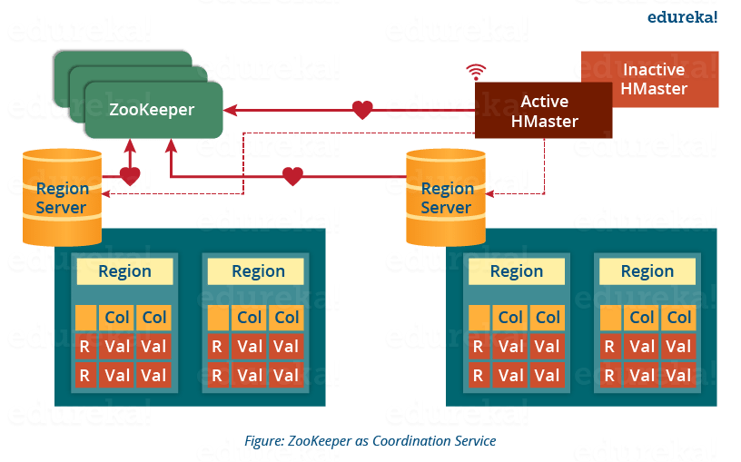
A few words on ZooKeeper (1)
HBase on Hadoop
Pagina ‹#›
Notes:
‹#›

Slide 19

A few words on ZooKeeper (2)
Distributed cluster coordination
software between servers.
Leader Election for master node
Uses “ensemble” concept
Uses a shared hierarchical
namespace where data registers
are called “znodes”.
Can be managed manually in
HBase.
ZooKeeper servers (the quorum) should run on separate nodes. The system stays available only if a majority of the quorum is available.
An odd number of servers avoids split brain problem.
If something is wrong, always check the logs to see whether ZooKeeper is running on all nodes or the regionservers are down!
HBase on Hadoop
Pagina ‹#›
Notes:
‹#›

Slide 20
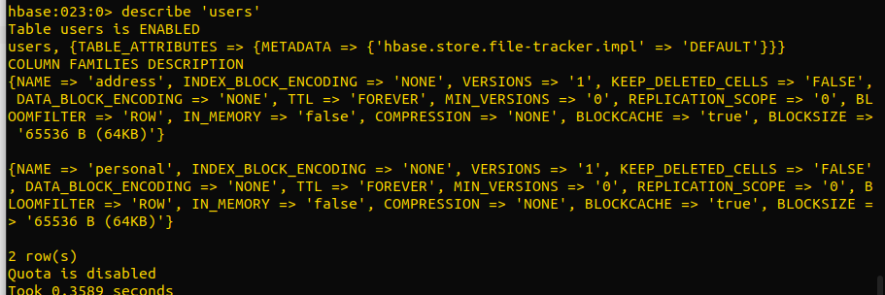
HBase: supported operations (1)
Usage with hbase shell on master node
create <table name>, <first column family>, <second col. family>,...
put <table name>, <row name>, <c.f.name:attribute name>, <value>
get <table name>, <row name>
scan <table name>
deleteall <table name>, <row name>
delete <table name>, <row name>, <col. family: col name>
changing the schema: disable/enable and alter
list
describe <table name>
drop <table name>
create_namespace,
describe_namespace
HBase on Hadoop
Pagina ‹#›
Notes:
‹#›

Slide 21
HBase: supported operations (2)
There are also many filters:
scan <table>, { FILTER => <FilterType(=, row_key)> }
PrefixFilter(<prefix_>)
RowFilter(=, <rowkey>)
SingleColumnValueFilter(‘personal’, ‘name’, =, ‘string:Alice’)
TimestampsFilter(<timestamp>)
PageFilter(<numpages>) limits result to first <numpages> rows
ColumnRangeFilter(<first col>, true, <lastcol>, true) to specify range of columns to include in result
KeyOnlyFilter returns only keys, not values
ValueFilter filters rows by value in any column
FilterList(ALL, filter1(...), filter2(...), …)
HBase on Hadoop
Pagina ‹#›
Notes:
‹#›

Slide 22
HBase: supported operations (3)
STARTROW and STOPROW
scan <table>, {
STARTROW => 1,
STOPROW < 11,
FILTER => <some filter>
}
Can be used to specify ranges of keys and in combination with filters.
HBase on Hadoop
Pagina ‹#›
Notes:
‹#›

Slide 23
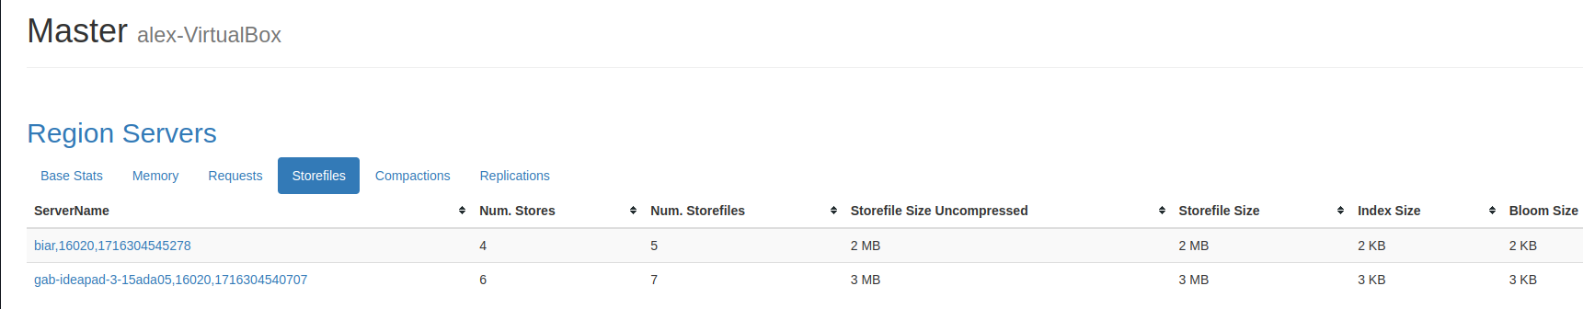
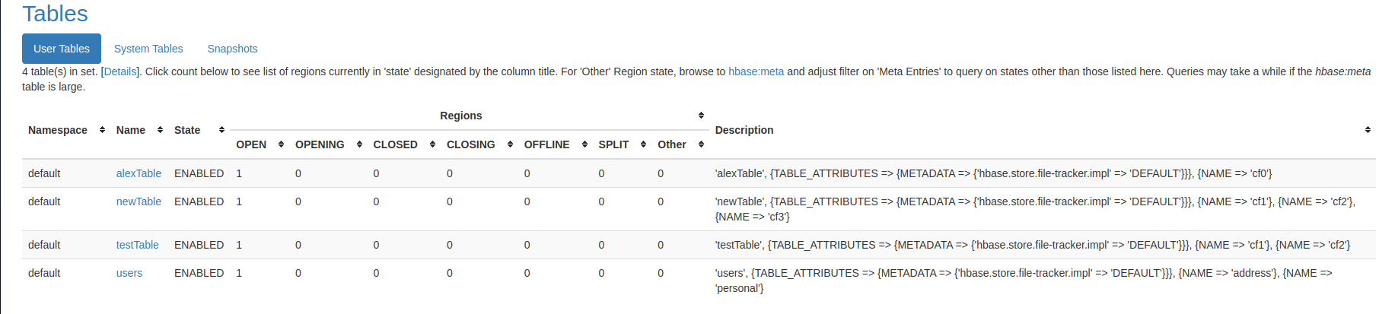
HBase: cluster monitoring (1)
Go to masternode:16010
HBase on Hadoop
Pagina ‹#›
Notes:
‹#›

Slide 24
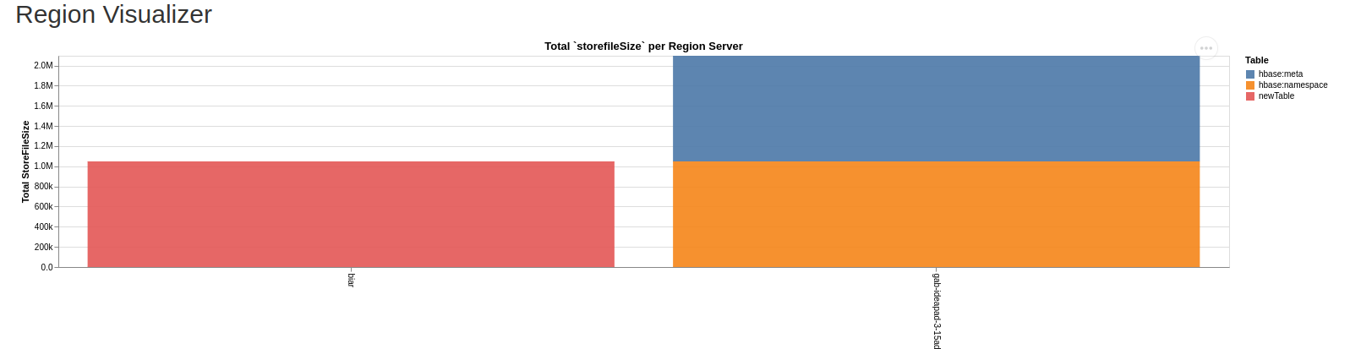
HBase: cluster monitoring (2)
HBase on Hadoop
Pagina ‹#›
Notes:
‹#›

Slide 25
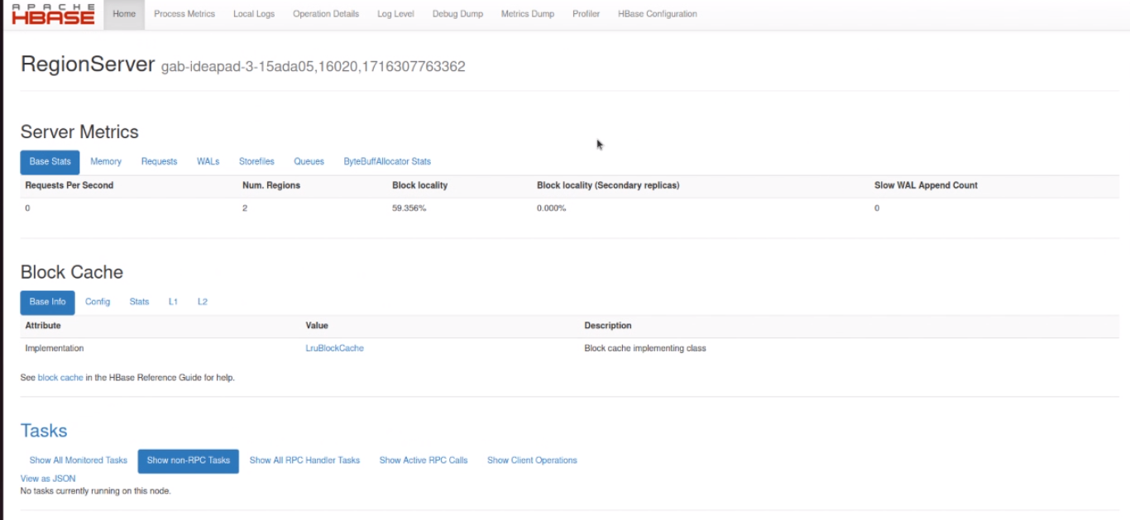
HBase: regionserver monitoring
HBase on Hadoop
Pagina ‹#›
Notes:
‹#›

Slide 26
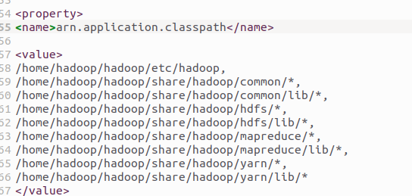
HBase: MapReduce
Modify yarn-site.xml:
Results of mapreduce will be uploaded either on hdfs or table.
MapReduce is the only way to perform aggregations directly on HBase.
Other possibilities include mapping the data into relational model (Hive, Phoenix).
HBase on Hadoop
Pagina ‹#›
Notes:
‹#›

Slide 27
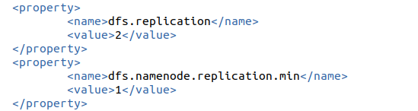
HBase: crash recovery
With the sufficient level of replication, crashes of region servers can be recovered.
Regions will be automatically transferred from a crashed region server to an available one.
WALs can be accessed to recover recently performed operations, that had not been flushed yet (WAL replay).
In original HBase version, the HMaster is a single point of failure.
These properties ensure a replication factor of 2 when there is no crash of datanodes.
HBase on Hadoop
Pagina ‹#›

